Slide 1
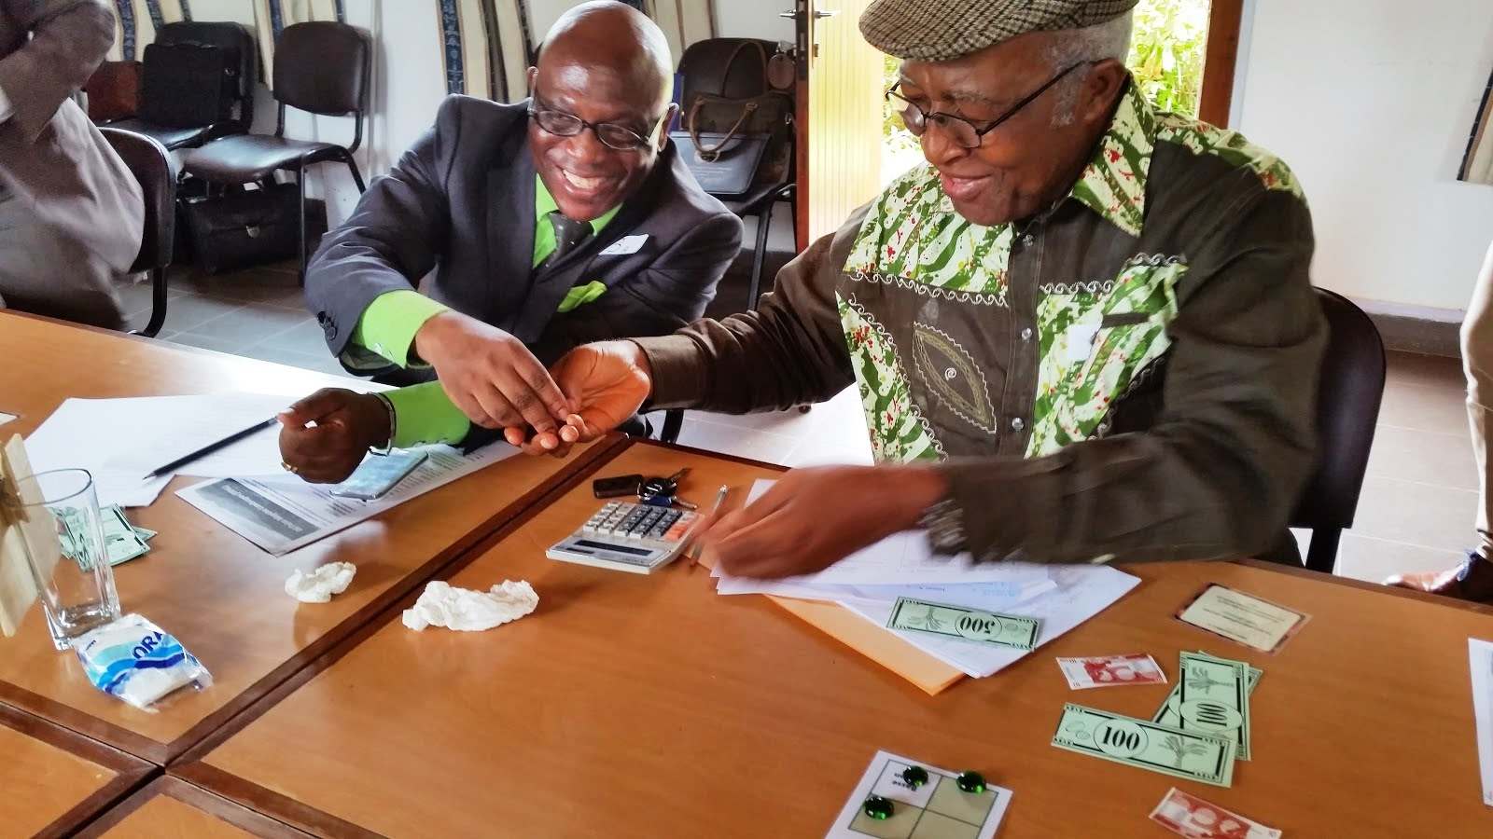
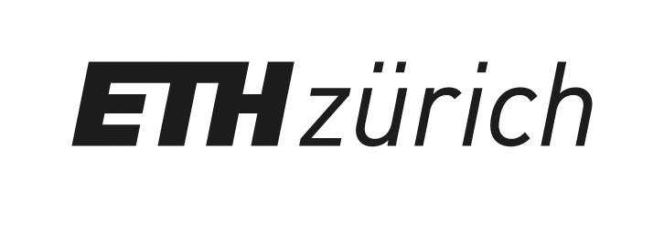
CoPalCam : Exploring the complexities of the Palm Oil Supply Chain in Cameroon.
Eglantine FAUVELLE, Patrice LEVANG, Emmanuel NGOM, Anne DRAY, Ludovic MIARO, Durrel NZENE HALLESON, Claude GARCIA
Participatory modelling,stakeholder engagement and capacity building through role playing games

Slide 2
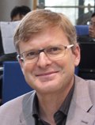
Notes:
During the introduction of the conference, Paul Leadley said there are too few documented instances of scenarios informing policies. He also regretted the lack of involvment of policy makers in research projects . We have heard it is difficult to engage stakeholders in a meaningfull dialogue and there are calls by the CBD and the others agencies, encouraging intitiatives to promote the use of scenarios in decision making.
Well, here we will tell you how we did precisely that, in the case of the palm oil supply chain in Cameroon.

Slide 3
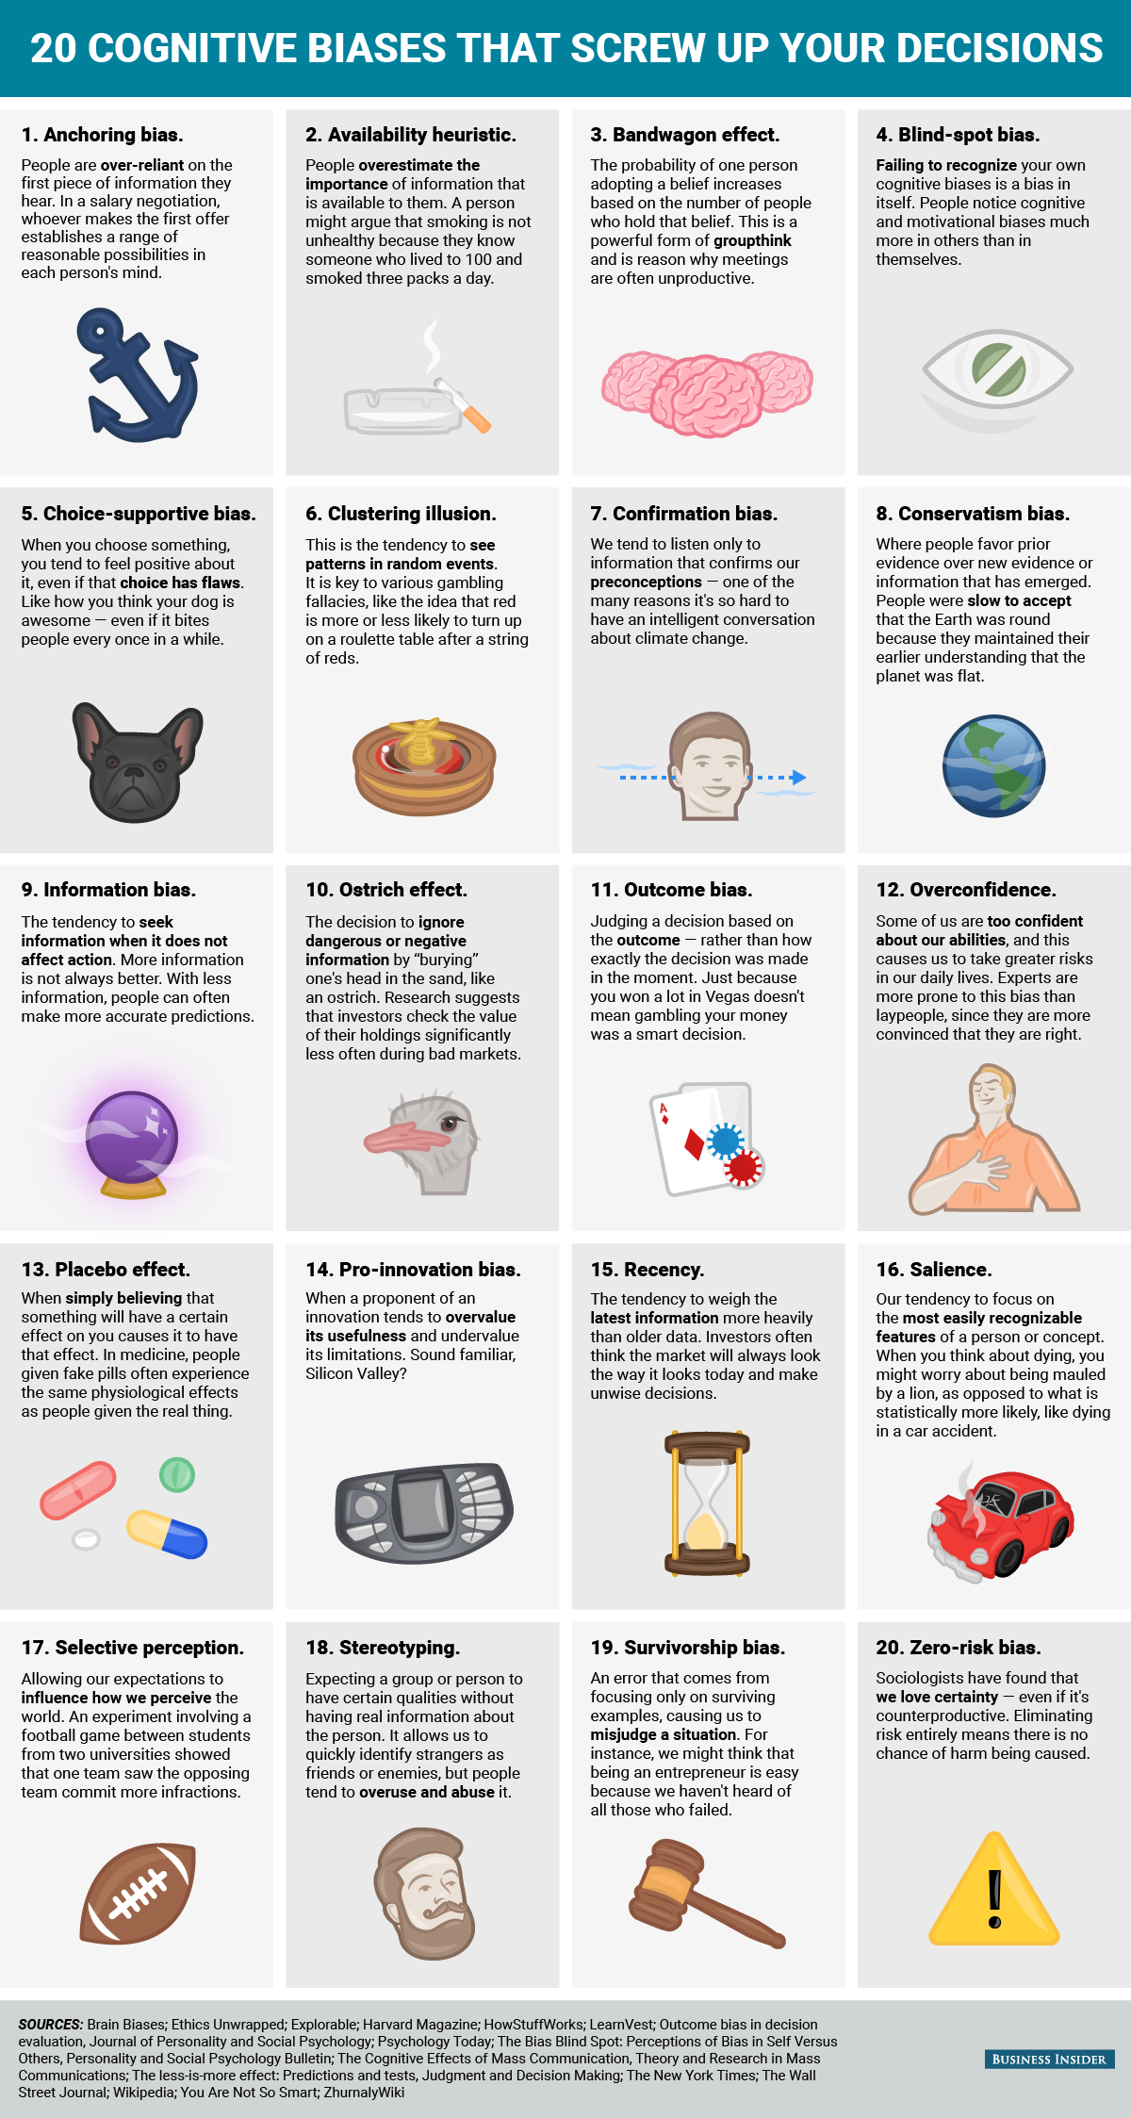
Notes:
List of the 20 recognized cognitive biaises that cloud our judgement
Look at this one ➔ the overconfidence = experts are particularly exposed to this biais . Their expertise entilte them to their opinion and they are thus more prone to make mistakes.
We saw an example of this yeasterday in a presentation on the mega trends and game changes in Japan in which opinions of experts were much more extreme than those of the laypeople
The tradtionnal response to this biais is to confront experts however this fails because rethorics takes over and instead of talking of the topic it can become a battle of will or ego.
A more constructive approach is to let them consider the complexity of the system they are talking about . To overcome this biais the experts need to be confronted to the complixity of the system they deal with., Psychologists have shon that this confrontation shatters their illusion of understanding and therefore reduces that biais of overconfidence.
And this is a first step towards a more construcctive dialogue and creation of new innovative solutions.
This is the objective of construction of a more constru tive dialogue = key obj of our approach. Tha tis what we tried to do to deal with the issues the palm oil supply chain is facing in Cameroon.

Slide 4
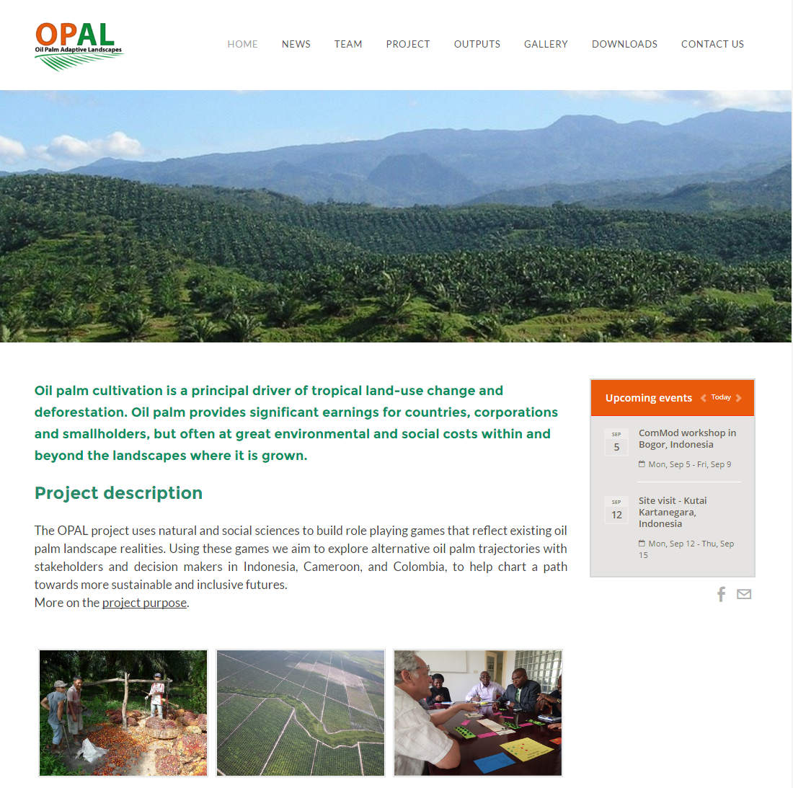
Notes:
Le projet OPAL financé par la coopération suisse, en collab avec cirad et eth, cherche a comprendre le impacts du développement de l’huile de palme dans trois pays Colombie, Cameroun et Indonésie, où les enjeux sont radicalement différents. Et de travailler à l’élaboration de scénarios / exploreer diférents futurs possible de dévlpt de la filière dans 3 pays de prod
Ici nous allons vs présenter le w réalisé au cameroun

Slide 5
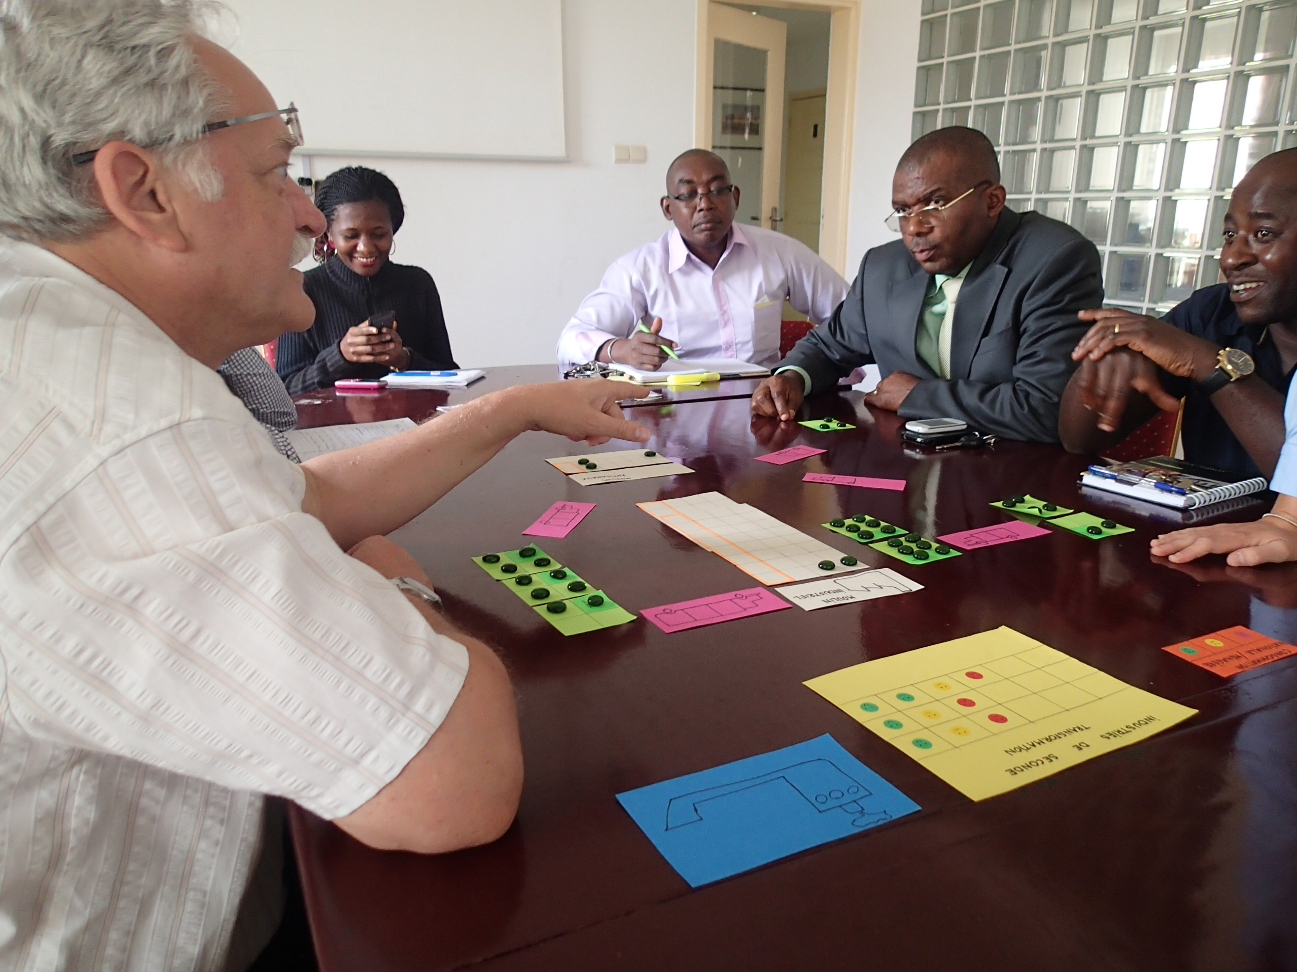
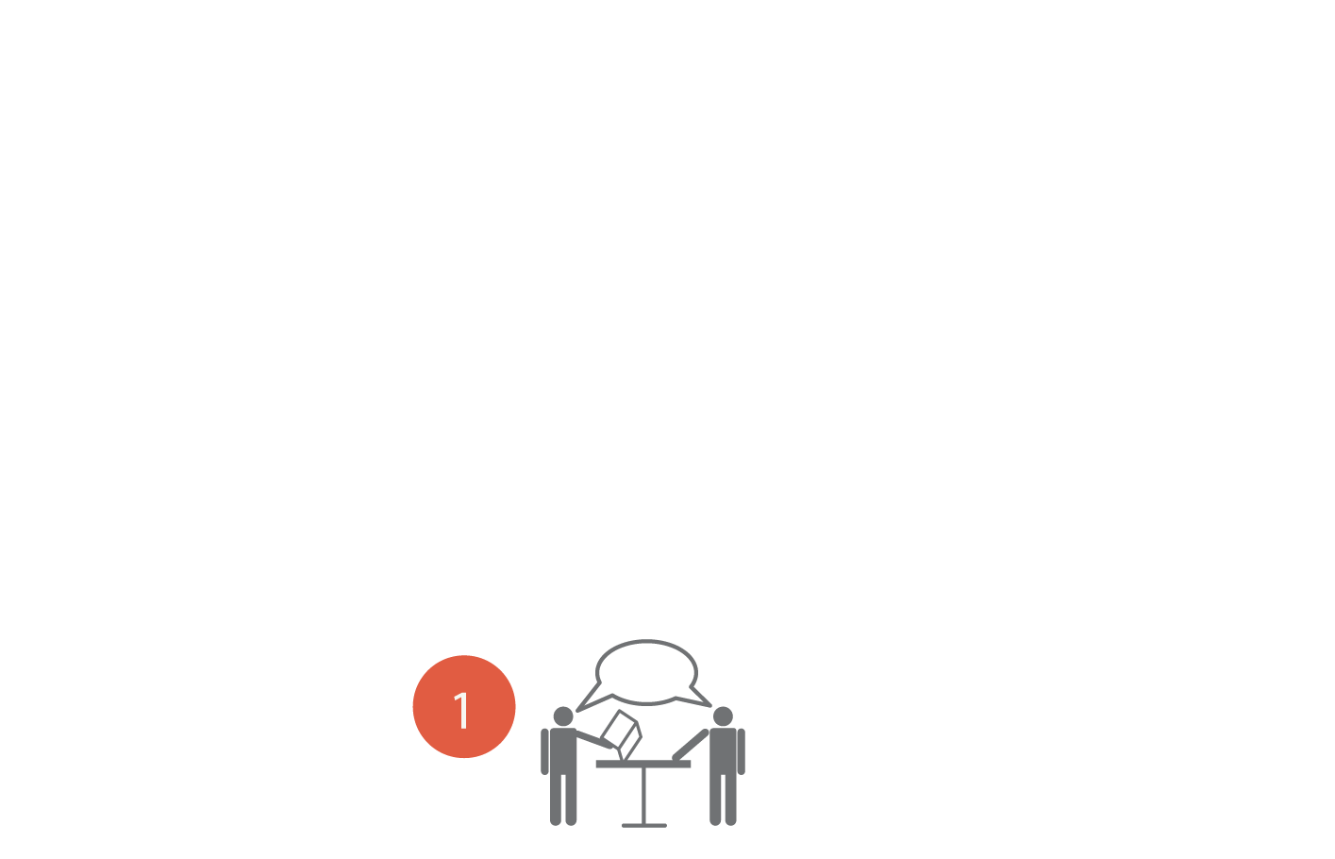
Expert knowledge elicitation
The core: an agent-based model based on complex economic processes
Notes:
We built our cncpetual model based on expert knowledge and

Slide 6
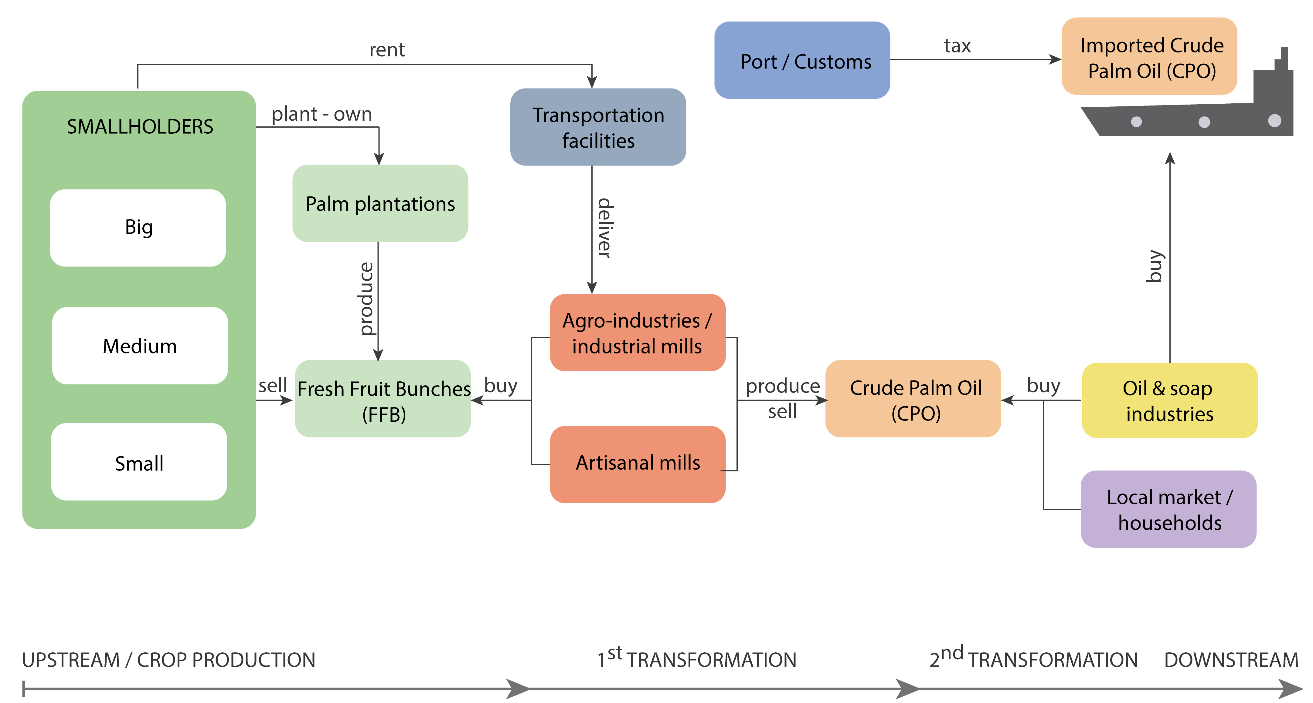
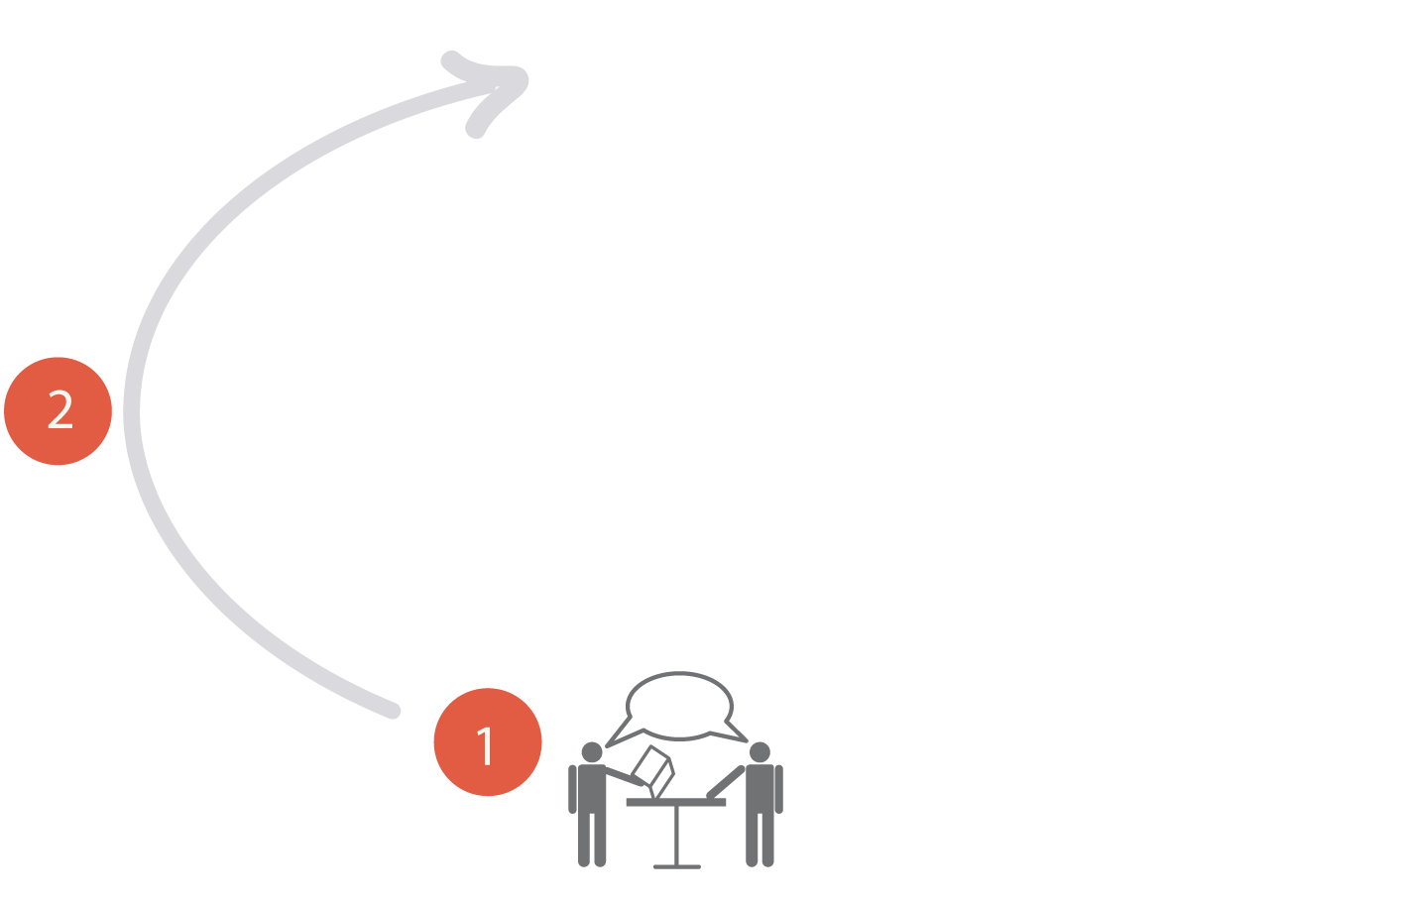
Expert knowledge elicitation
The core: an agent-based model based on complex economic processes
Conceptual modelling
Notes:
We built our cncpetual model based on expert knowledge and

Slide 7
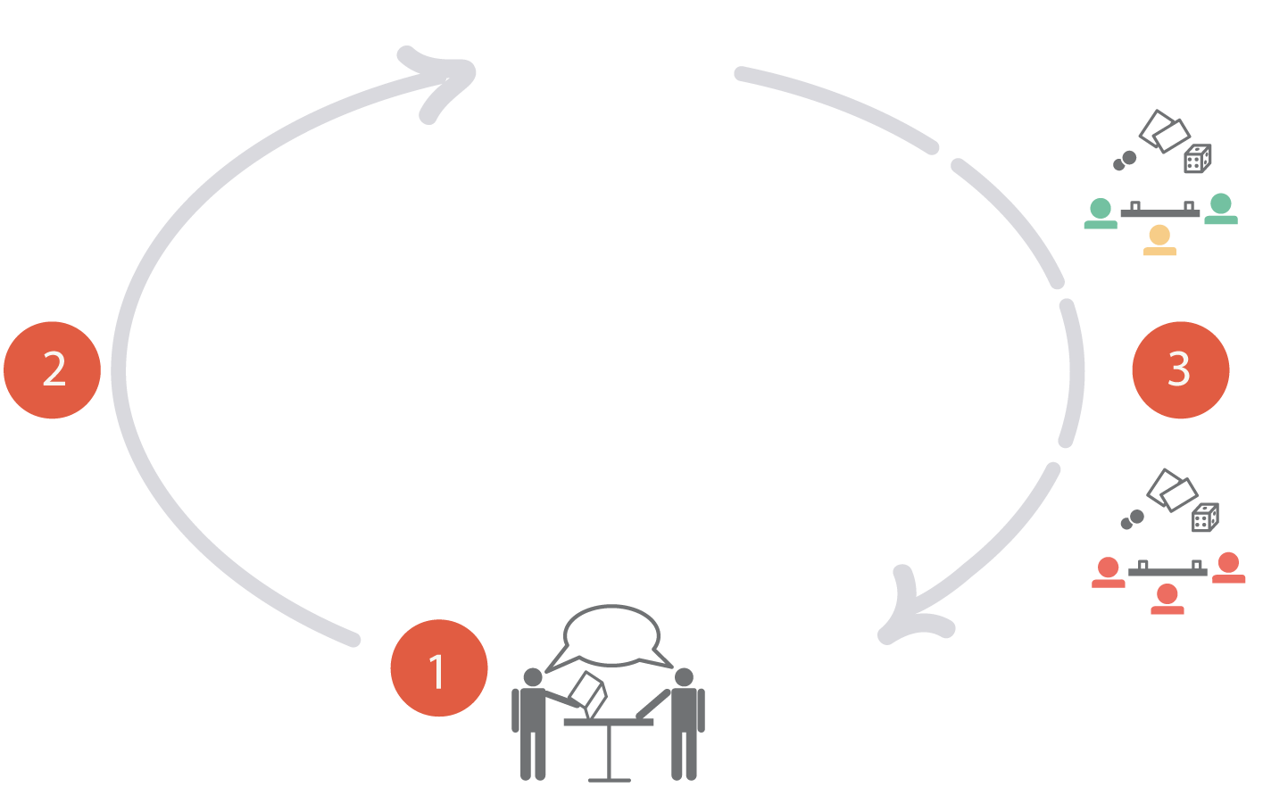
Expert knowledge elicitation
The core: an agent-based model based on complex economic processes
Conceptual modelling
Fine tuning & validation
Notes:
We built our cncpetual model based on expert knowledge and

Slide 8
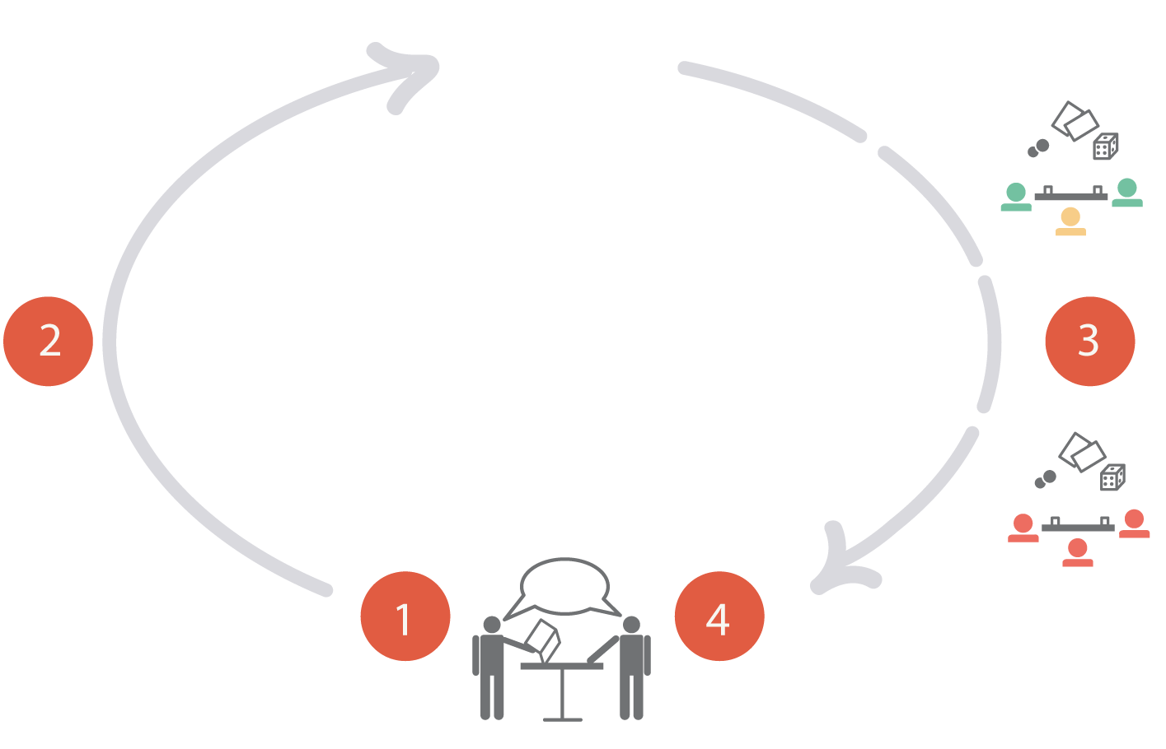
Expert knowledge gathering
The core: an agent-based model based on complex economic processes
Conceptual modelling
Fine tuning & validation
Game sessions
Notes:
We built our cncpetual model based on expert knowledge and

Slide 9
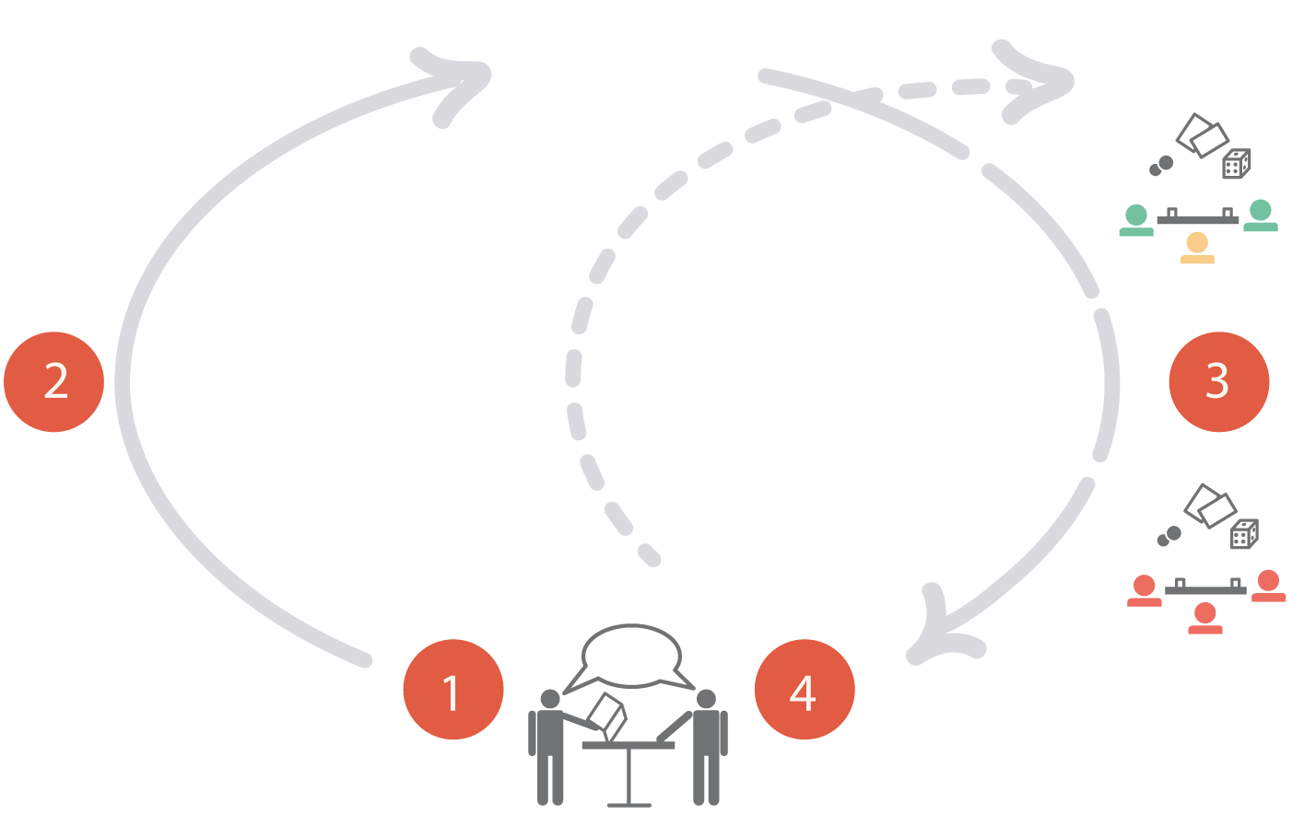
Expert knowledge elicitation
Conceptual modelling
Fine tuning & validation
Game sessions
Notes:
We built our cncpetual model based on expert knowledge and

Slide 10
CONCEPTUAL MODEL

Slide 11
CONCEPTUAL MODEL

Slide 12
CONCEPTUAL MODEL

Slide 13
CONCEPTUAL MODEL

Slide 14
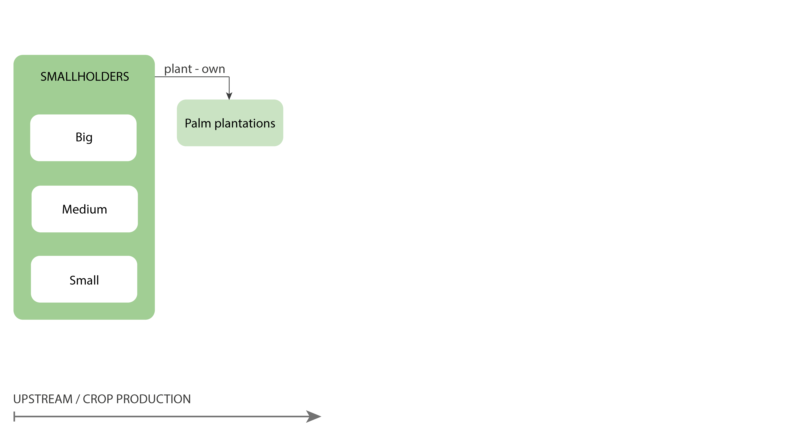
CONCEPTUAL MODEL

Slide 15
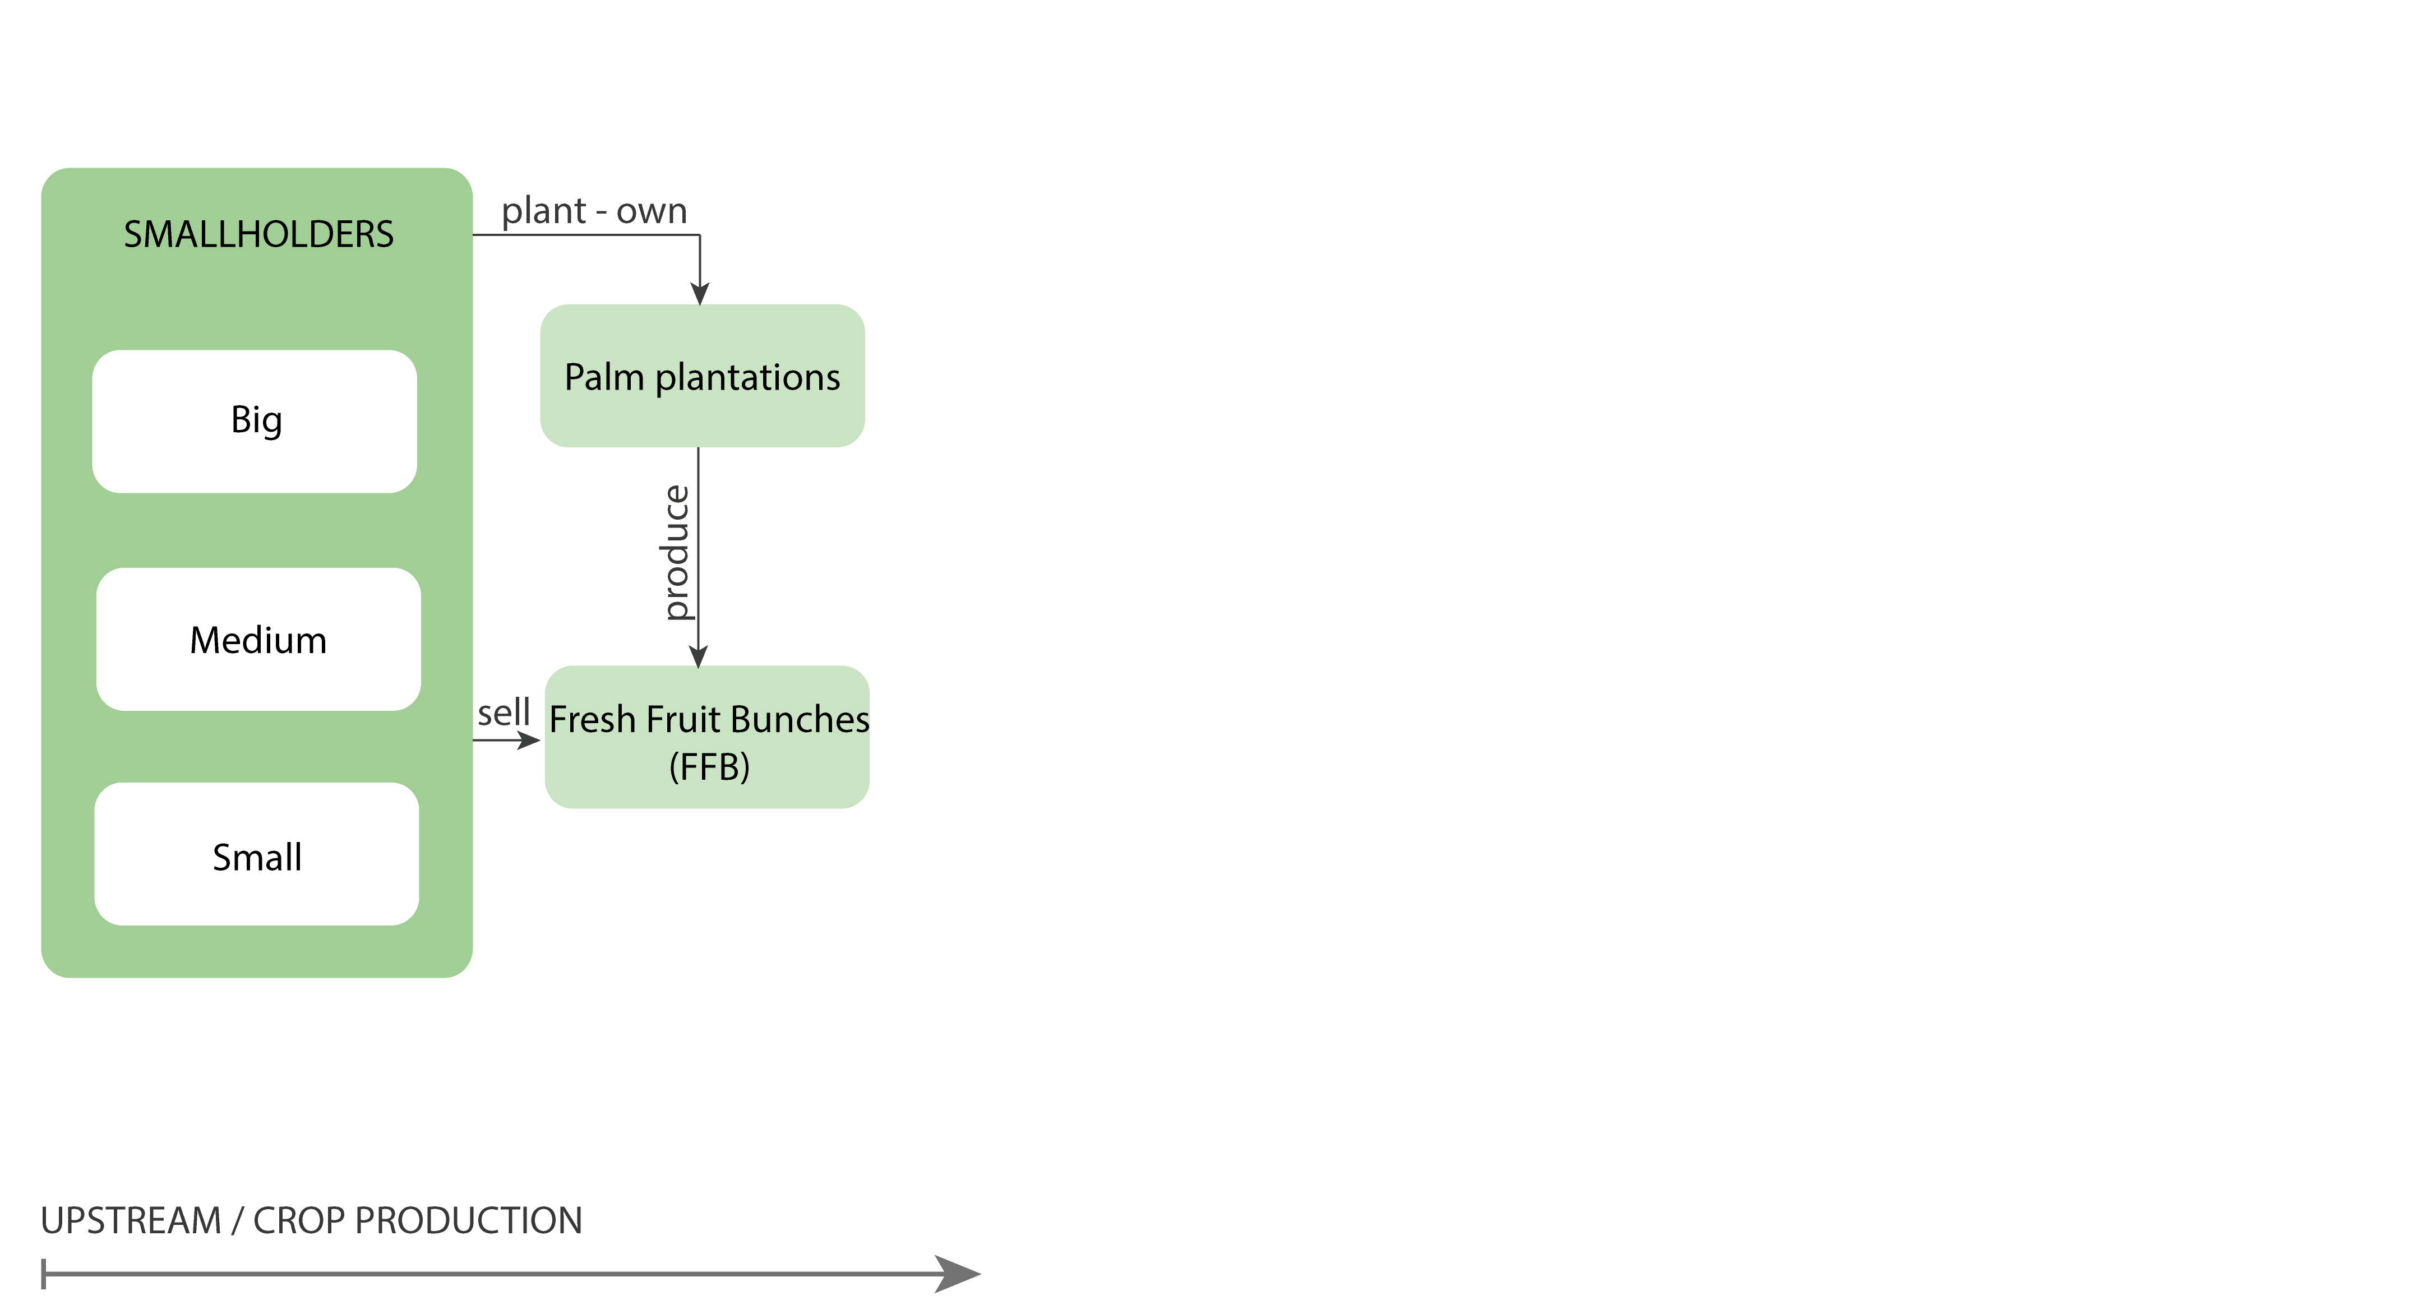
CONCEPTUAL MODEL

Slide 16
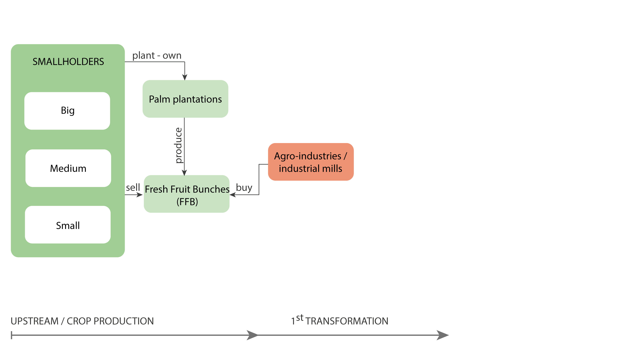
CONCEPTUAL MODEL

Slide 17
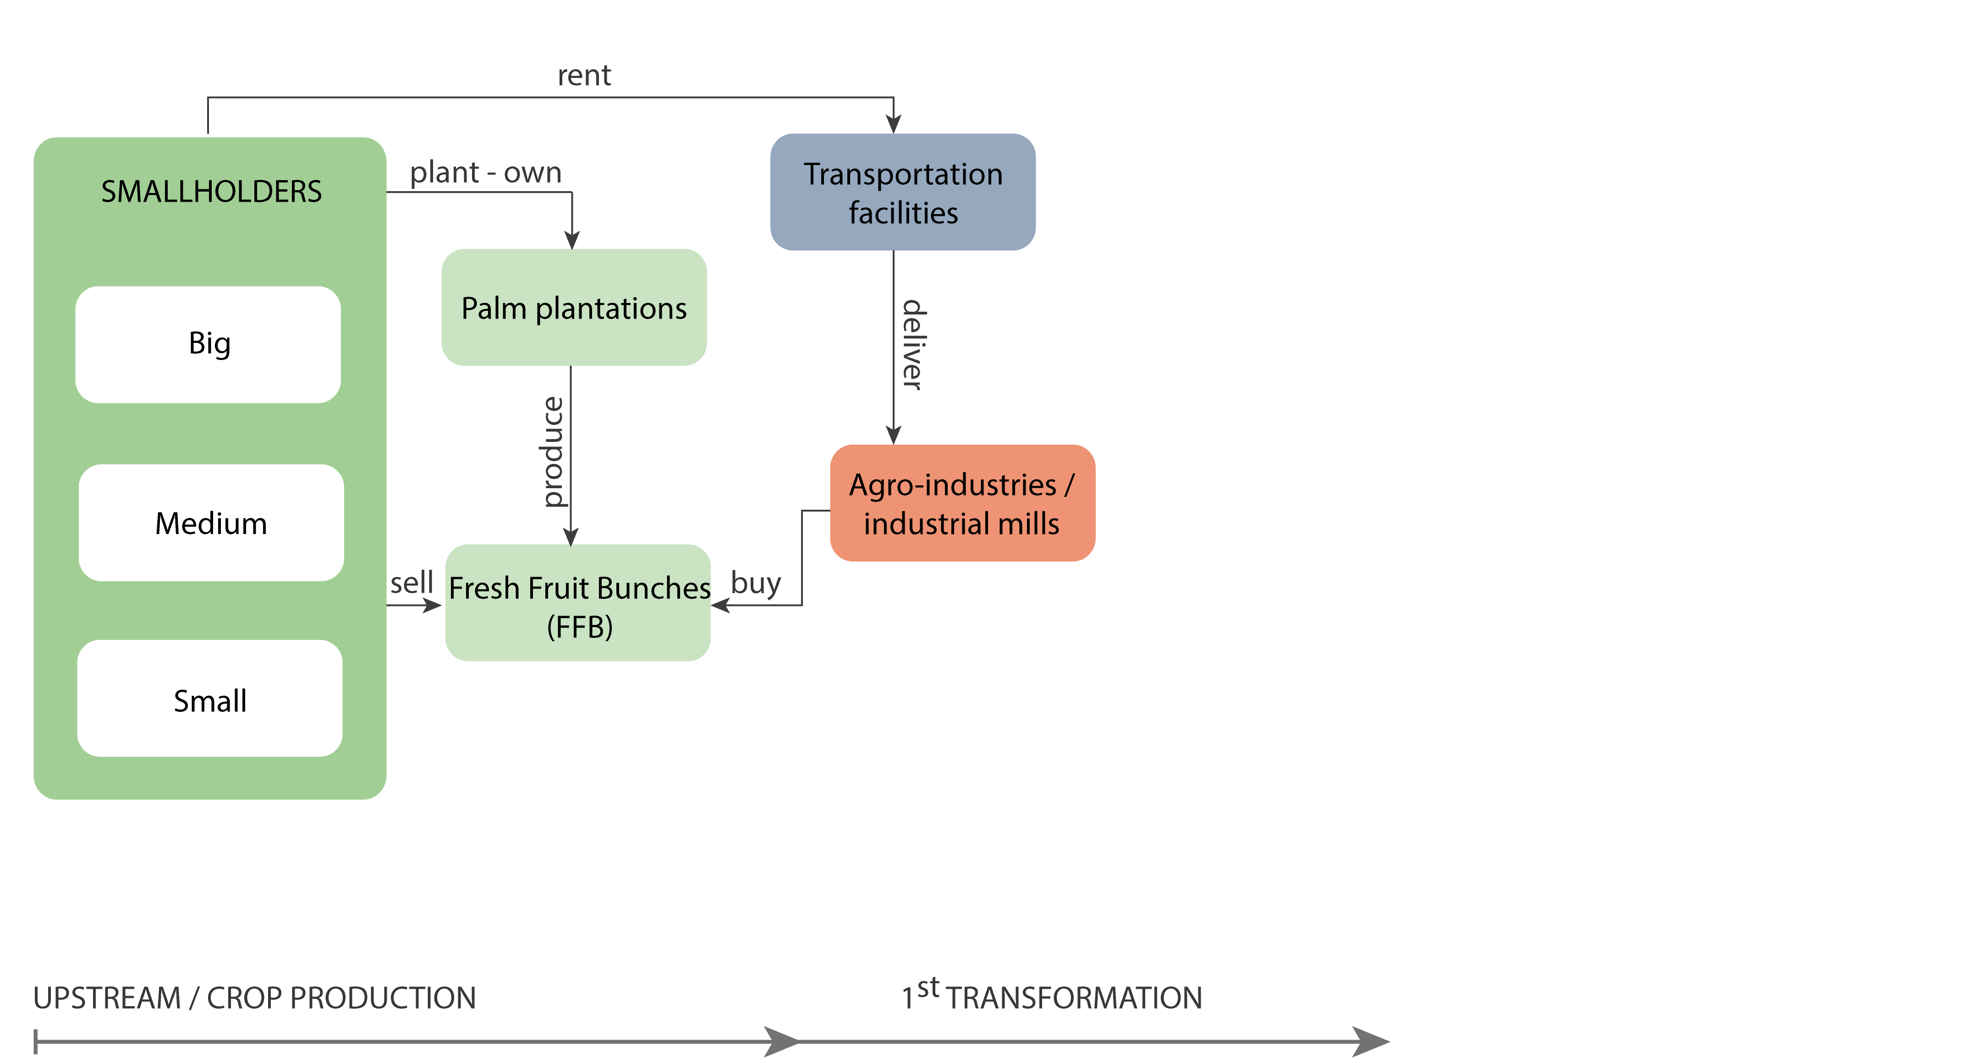
CONCEPTUAL MODEL

Slide 18
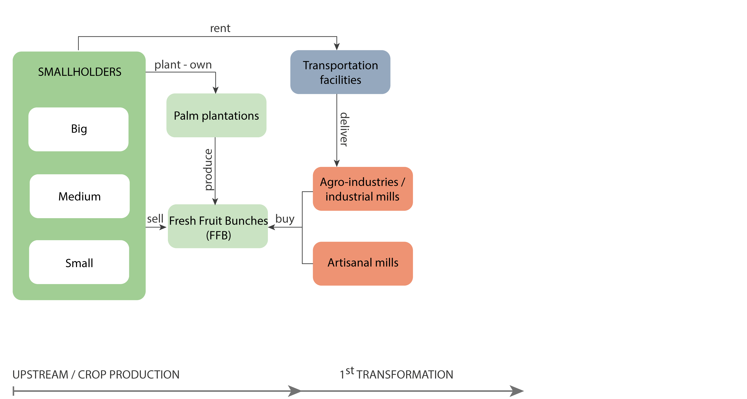
CONCEPTUAL MODEL

Slide 19
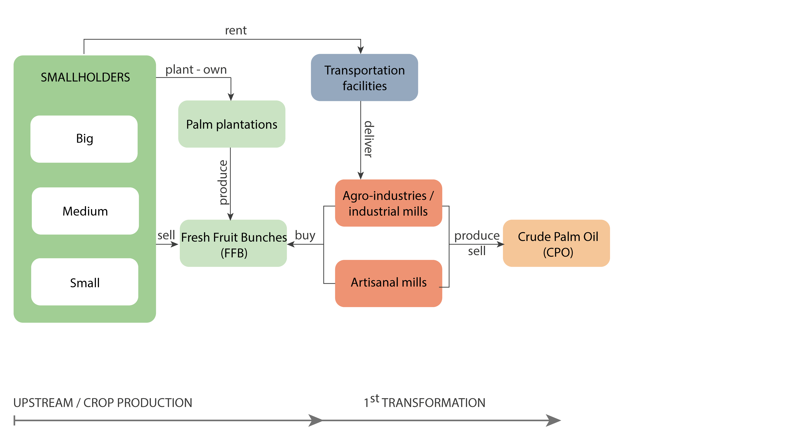
CONCEPTUAL MODEL

Slide 20
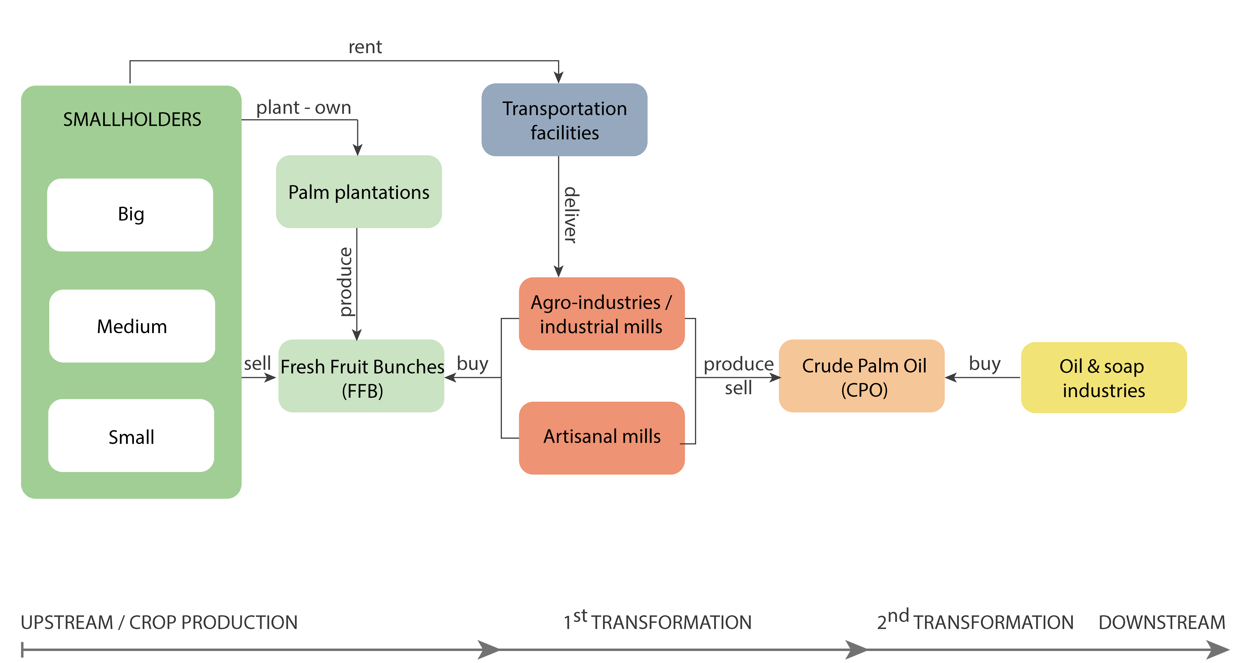
CONCEPTUAL MODEL

Slide 21
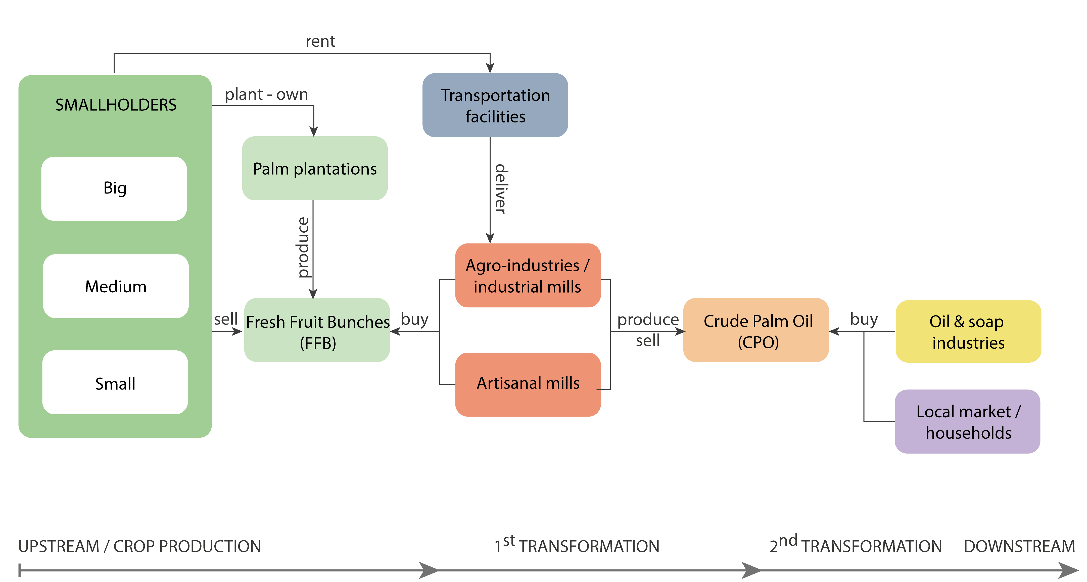
CONCEPTUAL MODEL

Slide 22
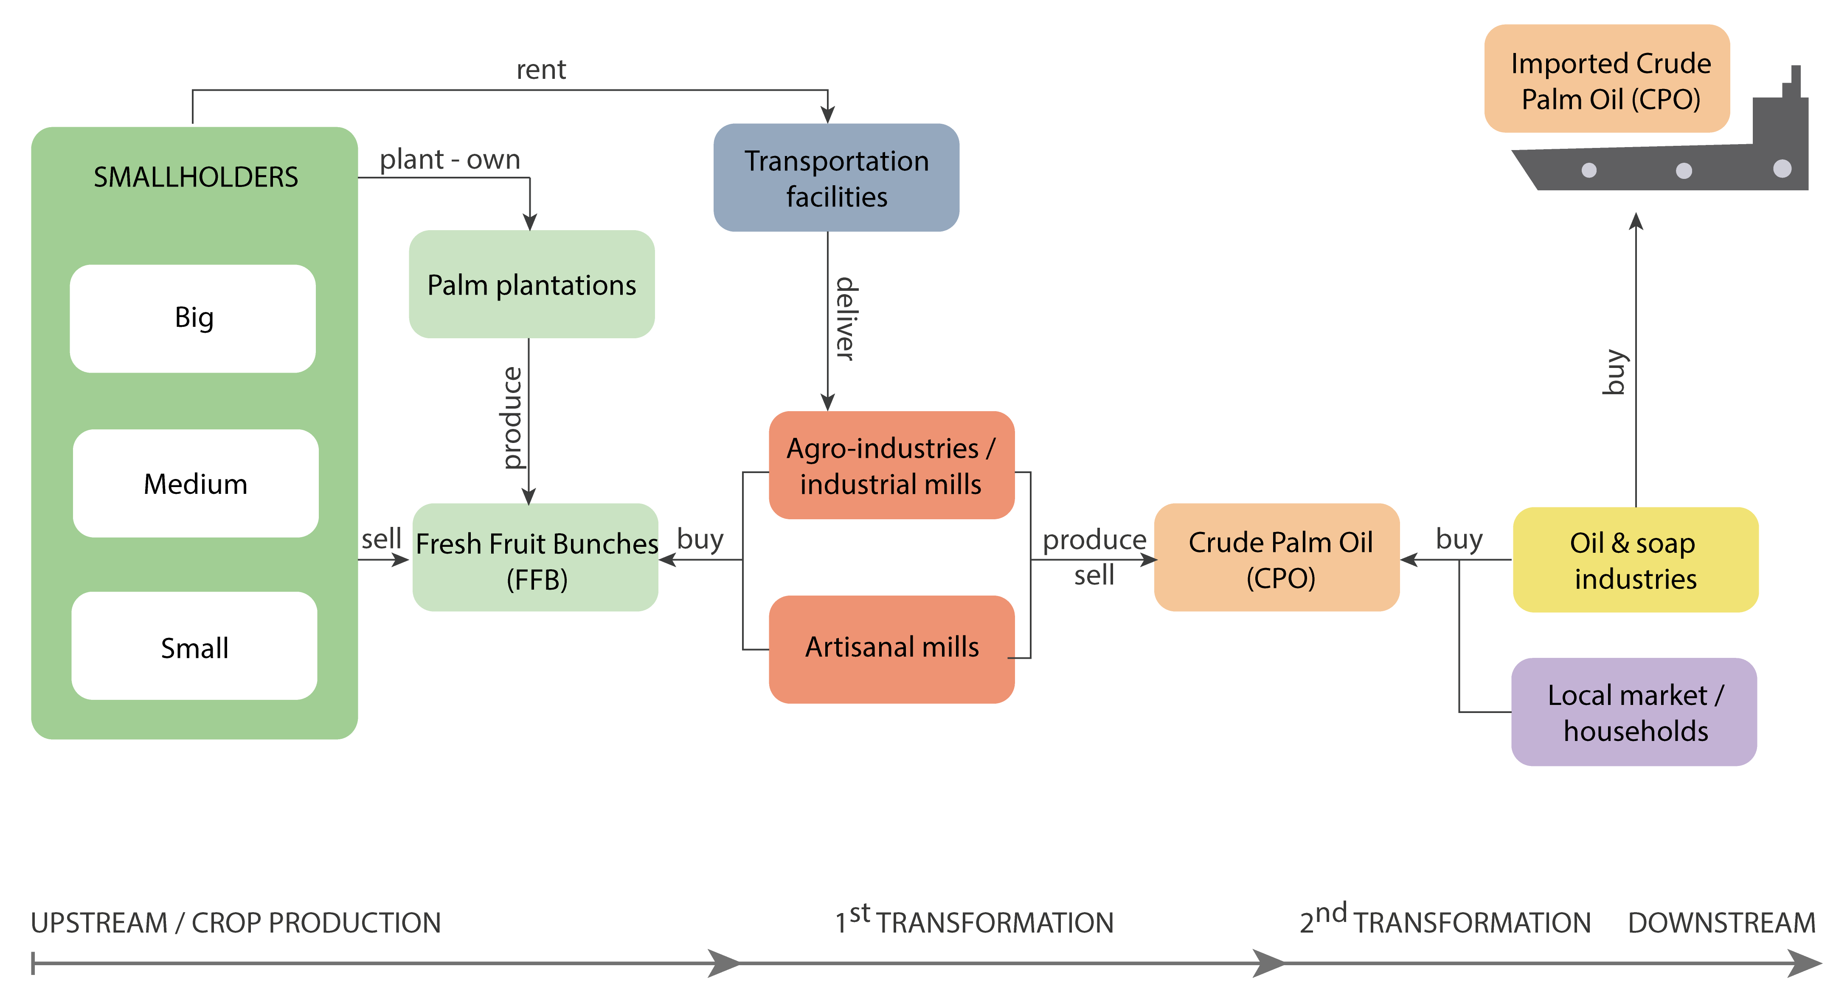
CONCEPTUAL MODEL

Slide 23
CONCEPTUAL MODEL

Slide 24
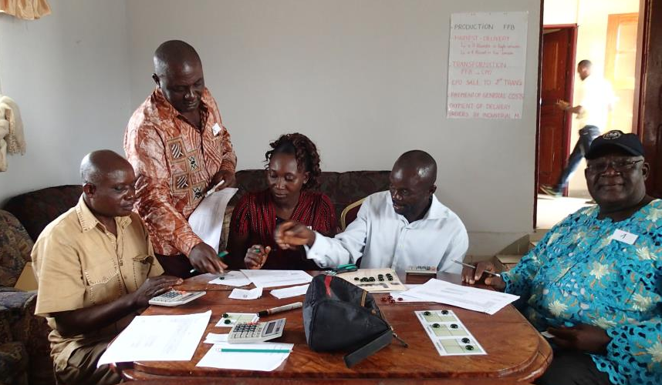
From a conceptual model to a Role-Playing Game
Notes:
Muyuka, 14-08-15 © Eglantine Fauvelle

Slide 25
Board
Research team
Marbles
Players / stakeholders

Slide 26
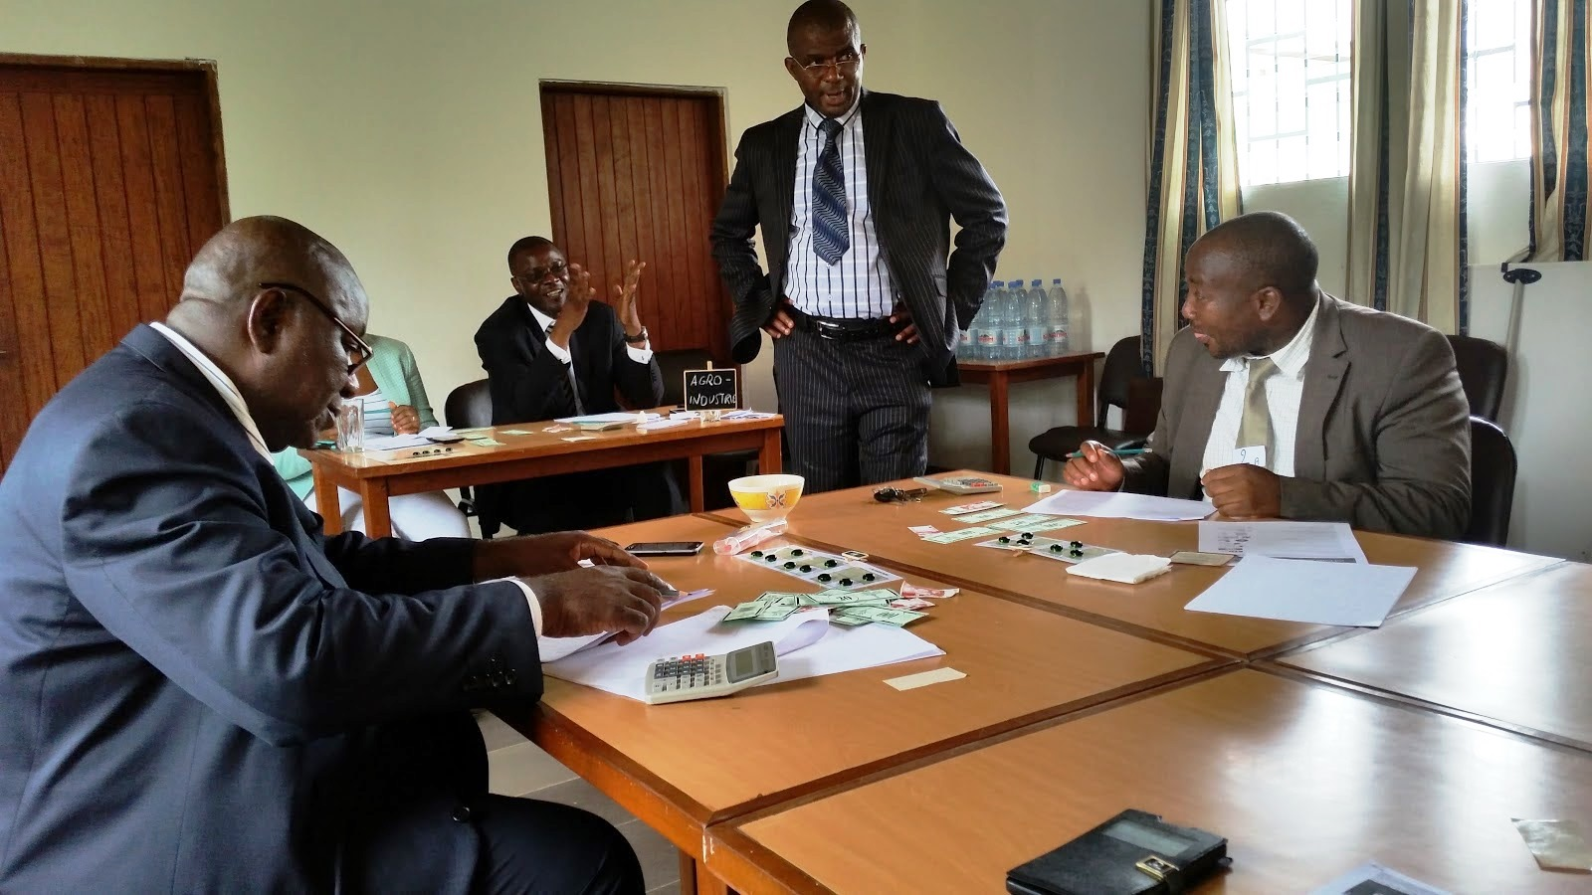
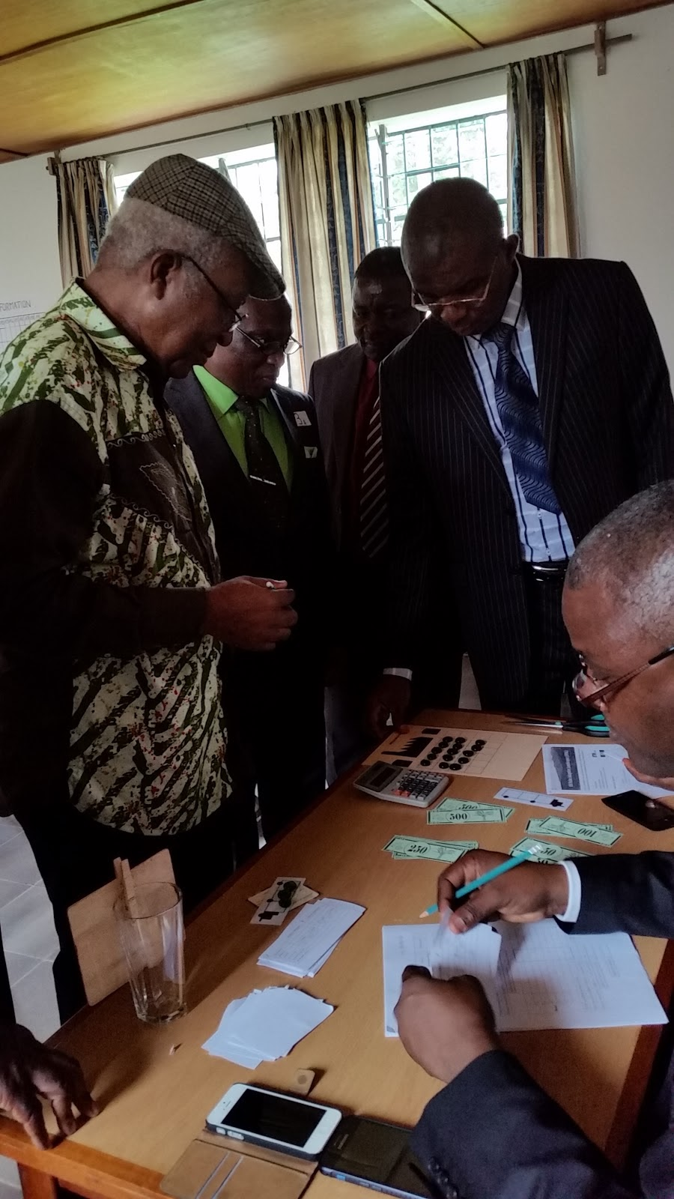
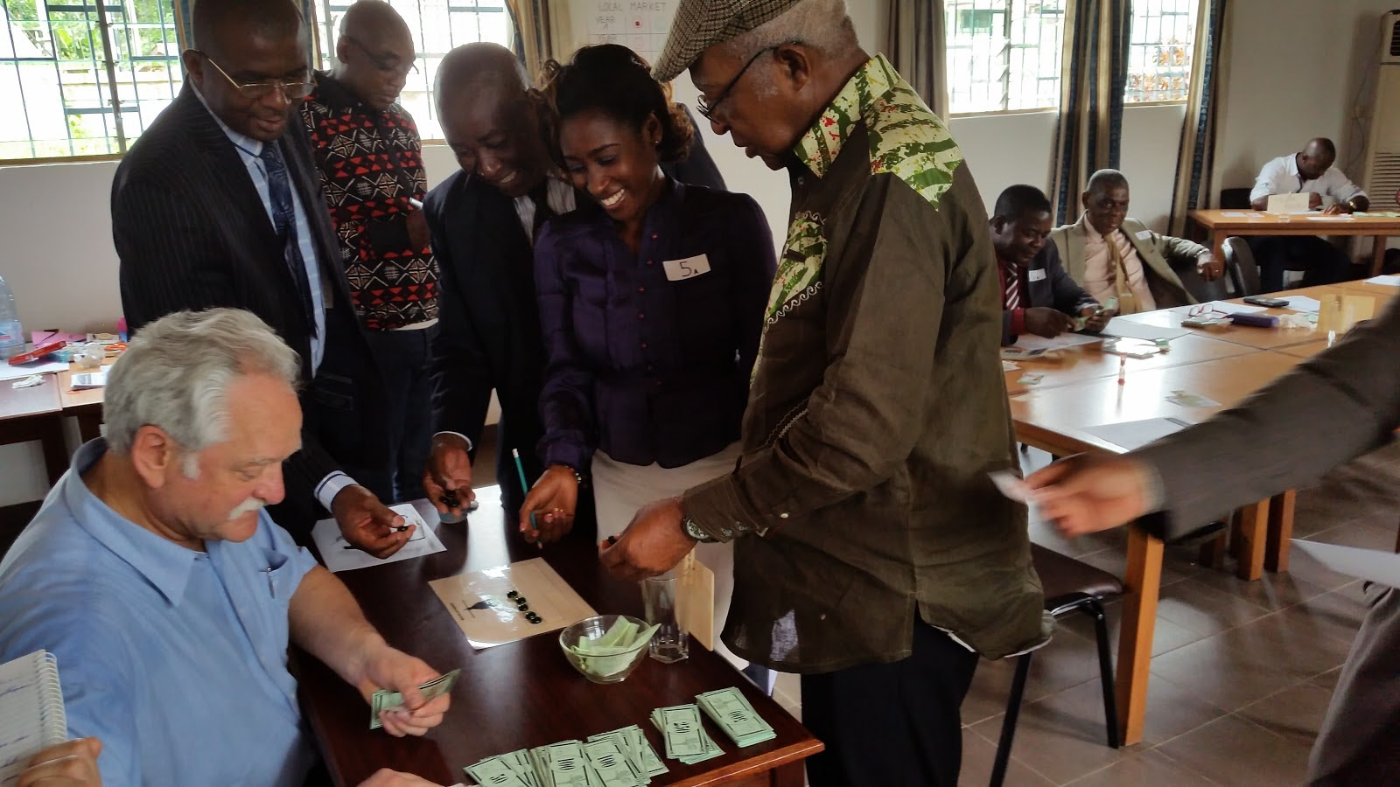

Slide 27
BROADENING SCOPES
Notes:
During the game session, the diff roles where emlbodied by diff rente representatives of palm oil supply chain and by policy makers, from the committee of regulation for palm oil supply chain. Here representative of min of trade agriculture and finance playing the role of palm oil small holderrs queiing to deliver their fruits to artisanal mills. Forcing people to develop strategies wioth different aims and knowledge than those they are used to considering their domain of expertise not only contriubute to individual learning by broadening socpes but is above all a step towards creation of innovative solution.

Slide 28
FOSTERING DIALOGUE
Notes:
The entire process is conductive to discussion and negociation. During the game, during the debriefing. In real life, when stakeholders in a supply hin are confronted to a problem,organizing workshops, seting the agendq – that is how solutions are sought: Here, during the game, exactly the same thing can be done, mimicns these processes, and promptiong the players to share their perceptions and think out of the box looking for alternatives, in a safe environment. It just requires setting a time frame (Five minutes!) and some soft skills of facilitation.

Slide 29
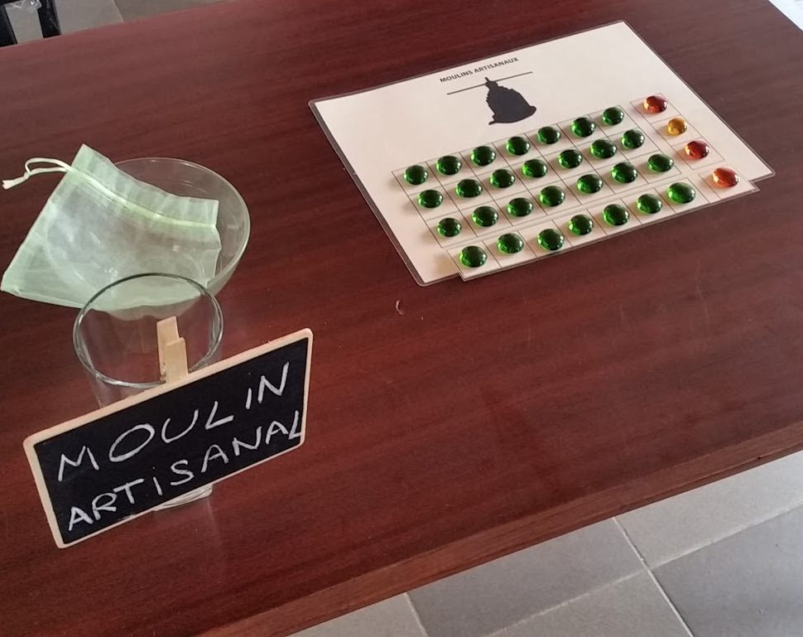
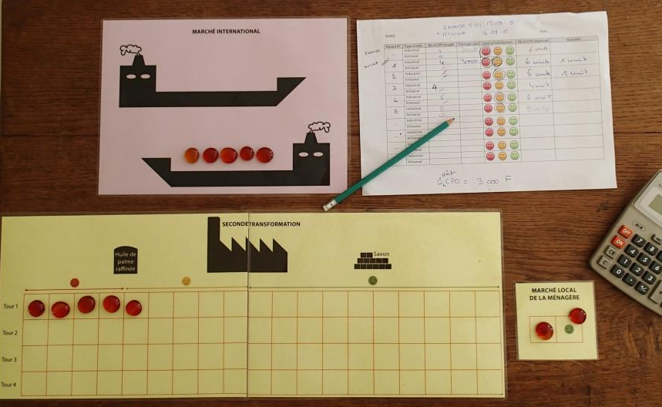
MONITORING
Notes:
During a game session we monitor and record different indicateors :
Flows of cash and products across the supp chain
We Also document (through notes, pictures, videos with consent) the interaction between the players , discussions, potential conflicts that emerge and how they are solved and the potential alliances
➔ generate a data set, which is akin to sociological surveys but with the difference that we can immedialty can refer to them and it thus serves as support for discussions.

Slide 30
DEBRIEFING
Notes:
But more importantly a game session is immediately followed by a debriefing and if individual learning may happen during game session, collective learning happens during the debriefing pahse (the research team and stakeholders)
During the game you can have individual learning
We can talk about the sterategies they dvpe, the success and failures and their reasons. We can talk about the outcomes and lessons learnt, compare the behaviour of the model to what they know of the real system and this acts as a social validation. Or can be the oppr to revise the model and refine it. This is the moiment when everybody gets feedbacks and learns.
As a side note¨:

Slide 31
OUTCOMES
Jacquis Kemleu Tchabgou – Secrétaire Général/Association des Raffineurs des Oléagineux du Cameroun (ASROC)
What have you learnt ?
« La session a été d'importance, fort intéressante et a permis aux acteurs de la Filière des Oléagineux notamment du Palmier à Huile, d'échanger dans un cadre différent de celui formel du Comité de Régulation de la Filière de l'huile de Palme et cette fois en situation.
Il était véritablement nécessaire qu'un atelier de cet acabit se tienne, en vue de sensibiliser non seulement les producteurs et les transformateurs, mais également leur partenaire institutionnel qu'est l'Etat, qui a un rôle certain à jouer et qui était fortement représenté »
Dialogue in a different arena, and in situation.
Helpful to increase awareness of producers, industries and the State
Notes:
Another form of debriefing can be after the serssion, a week after, we get back to the Skwho had time to think over and we ask them what they’ve learnt.
And here we have an example of such a feedbakc wich is notoriously diff to get in another kind of approach and to what Paul Leadley is refering.

Slide 32
OUTCOMES
Jacquis Kemleu Tchabgou – Secrétaire Général/Association des Raffineurs des Oléagineux du Cameroun (ASROC)
Which steps do you recommend?
« Je suggère un autre atelier devant intégrer la notion de qualité dans la production, l'aspect niveau du taux d'extraction et la mise en exergue du rôle de la 2ème transformation qui pousserait celle-ci à préfinancer les planteurs ainsi que les unités d'extraction.
Elle a enfin suggérée une réflexion devant porter sur la mise en place d'une inter-profession (entre producteurs et transformateurs) dans la Filière de l'huile de palme. »
Another workshop with new scenarios & roles
Include quality incentives Highlight the potential key-role of 2nd transformation
➔ Creation of a platform of producers, 1st + 2nd transformation ?

Slide 33
Notes:
1 - Un modèle très pédagogique qui permet de comprendre les difficultés auxquels sont confrontés les acteurs de la filière
2 - Une appropriation de l’outil (jeu) par les partenaires – avec un atelier organisé sans appui auprès des producteurs
3 - Une sensibilisation des décideurs à l’approche, et le souhait d’utiliser le modèle pour explorer des scénarios sur des questions

Slide 34
ENGAGEMENT
Notes:
Evething was possible because Emmanuel Ngom, a representative of Indepentend Small holders in the MINADER, sitting in the committee, was involved in the research project since inception, helping set the agenda, following the awareness creation workshops at project inception. HE saw the potiental of the tool and opened for us the doors of the committee, cajoling and selling the method to his peers. Such an entrypoint is priceless.

